Slide 1
Software Process
Sofware Process

Slide 2
Software Engineering
We have specified the problem domain – industrial strength software
  Besides delivering the software, cost, quality, and schedule are drivers
Software engineering is defined as the systematic approach for development of (industrial strength) software
Sofware Process

Slide 3
Process, People, Technology
Q&P is an essential goal
Q&P depends on people, process, and technology
  Processes help people become more productive and create fewer errors
  Tools help people execute some tasks in the process more efficiently and effectively
  So, process forms the core
Sofware Process

Slide 4
Software Process
Process is distinct from product – products are outcomes of executing a process on a project
SW Engg. focuses on process
Premise: Proper processes will help achieve project objectives of high QP
Sofware Process

Slide 5
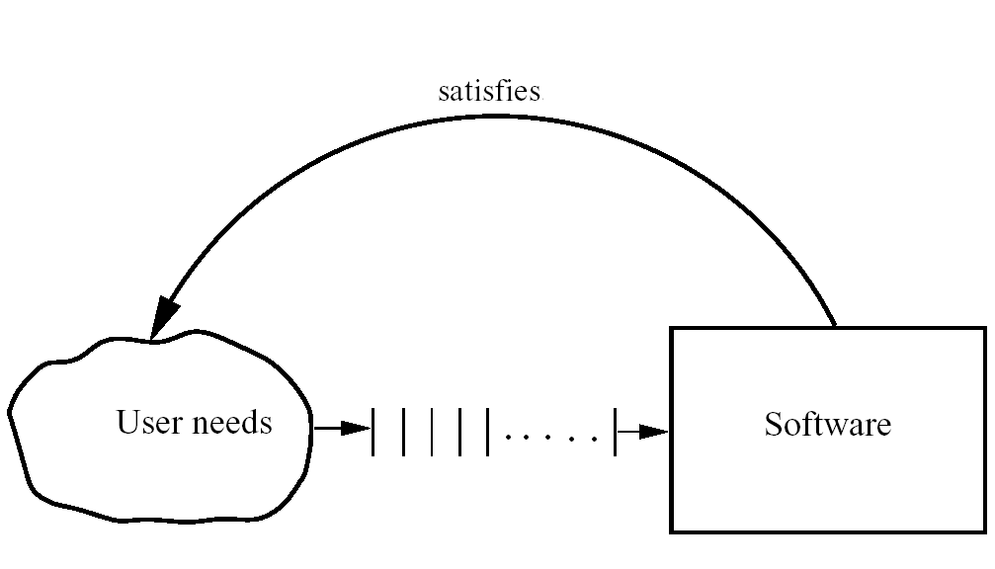
The software Development Problem
Sofware Process

Slide 6
Project and Process
A software project is one instance of the development problem
Development process takes the project from user needs to software
There are other goals of cost schedule and quality, besides delivering software
Need other processes
Sofware Process

Slide 7
Software Process…
Process: A sequence of steps performed to achieve some goal
Software Process: The sequence of steps performed to produce software with high quality, within budget and schedule
Many types of activities performed by diff people in a software project
Better to view software process as comprising of many component processes
Sofware Process

Slide 8
Component Software Processes
Two major processes
  Development – focuses on development and quality steps needed to engineer the software
  Project management – focuses on planning and controlling the development process
Development process is the heart of software process; other processes revolve around it
These are executed by different people
  developers execute engg. Process
  project manager executes the mgmt proces
Sofware Process

Slide 9
Component Processes…
Other processes
  Configuration management process: manages the evolution of artifacts
  Change management process: how changes are incorporated
  Process management process: management of processes themselves
  Inspection process: How inspections are conducted on artifacts
Sofware Process

Slide 10
Process Specification
Process is generally a set of phases
Each phase performs a well defined task and generally produces an output
Intermediate outputs – work products
At top level, typically few phases in a process
How to perform a particular phase – methodologies have been proposed
Sofware Process

Slide 11
ETVX Specification
ETVX approach to specify a step
  Entry criteria: what conditions must be satisfied for initiating this phase
  Task: what is to be done in this phase
  Verification: the checks done on the outputs of this phase
  eXit criteria: when can this phase be considered done successfully
A phase also produces info for mgmt
Sofware Process

Slide 12
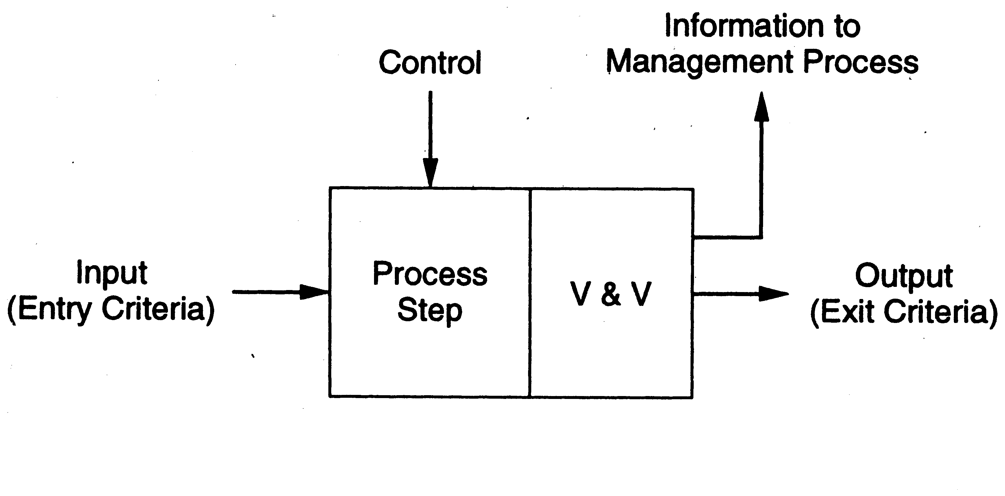
ETVX approach
Sofware Process

Slide 13
Development Process and Process Models
Sofware Process

Slide 14
Software Project
Project – to build a sw system within cost and schedule and with high quality which satisfies the customer
Suitable process needed to reach goals
Process should not just help produce the software but help achieve the highest Q&P
Sofware Process

Slide 15
Project’ s process and Process Models
For a project, the project’s process to be followed is specified during planning
A process model specifies a general process that is optimal for a class of problems
A project may select its process using one of the process models
Sofware Process

Slide 16
Development Process
A set of phases and each phase being a sequence of steps
Sequence of steps for a phase - methodologies for that phase.
Why have phases
  To employ divide and conquer
  each phase handles a different part of the problem
  helps in continuous validation
Sofware Process

Slide 17
Development Process
Commonly has these activities: Requirements analysis, architecture, design, coding, testing, delivery
Different models perform them in different manner
Sofware Process

Slide 18
Process Models
A process model specifies a general process, usually as a set of stages
This model will be suitable for a class of projects
I.e. a model provides generic structure of the process that can be followed by some projects to achieve their goals
Sofware Process

Slide 19
Waterfall Model
Linear sequence of stages/phases
Requirements – HLD – DD – Code – Test – Deploy
A phase starts only when the previous has completed; no feedback
The phases partition the project, each addressing a separate concern
Sofware Process

Slide 20
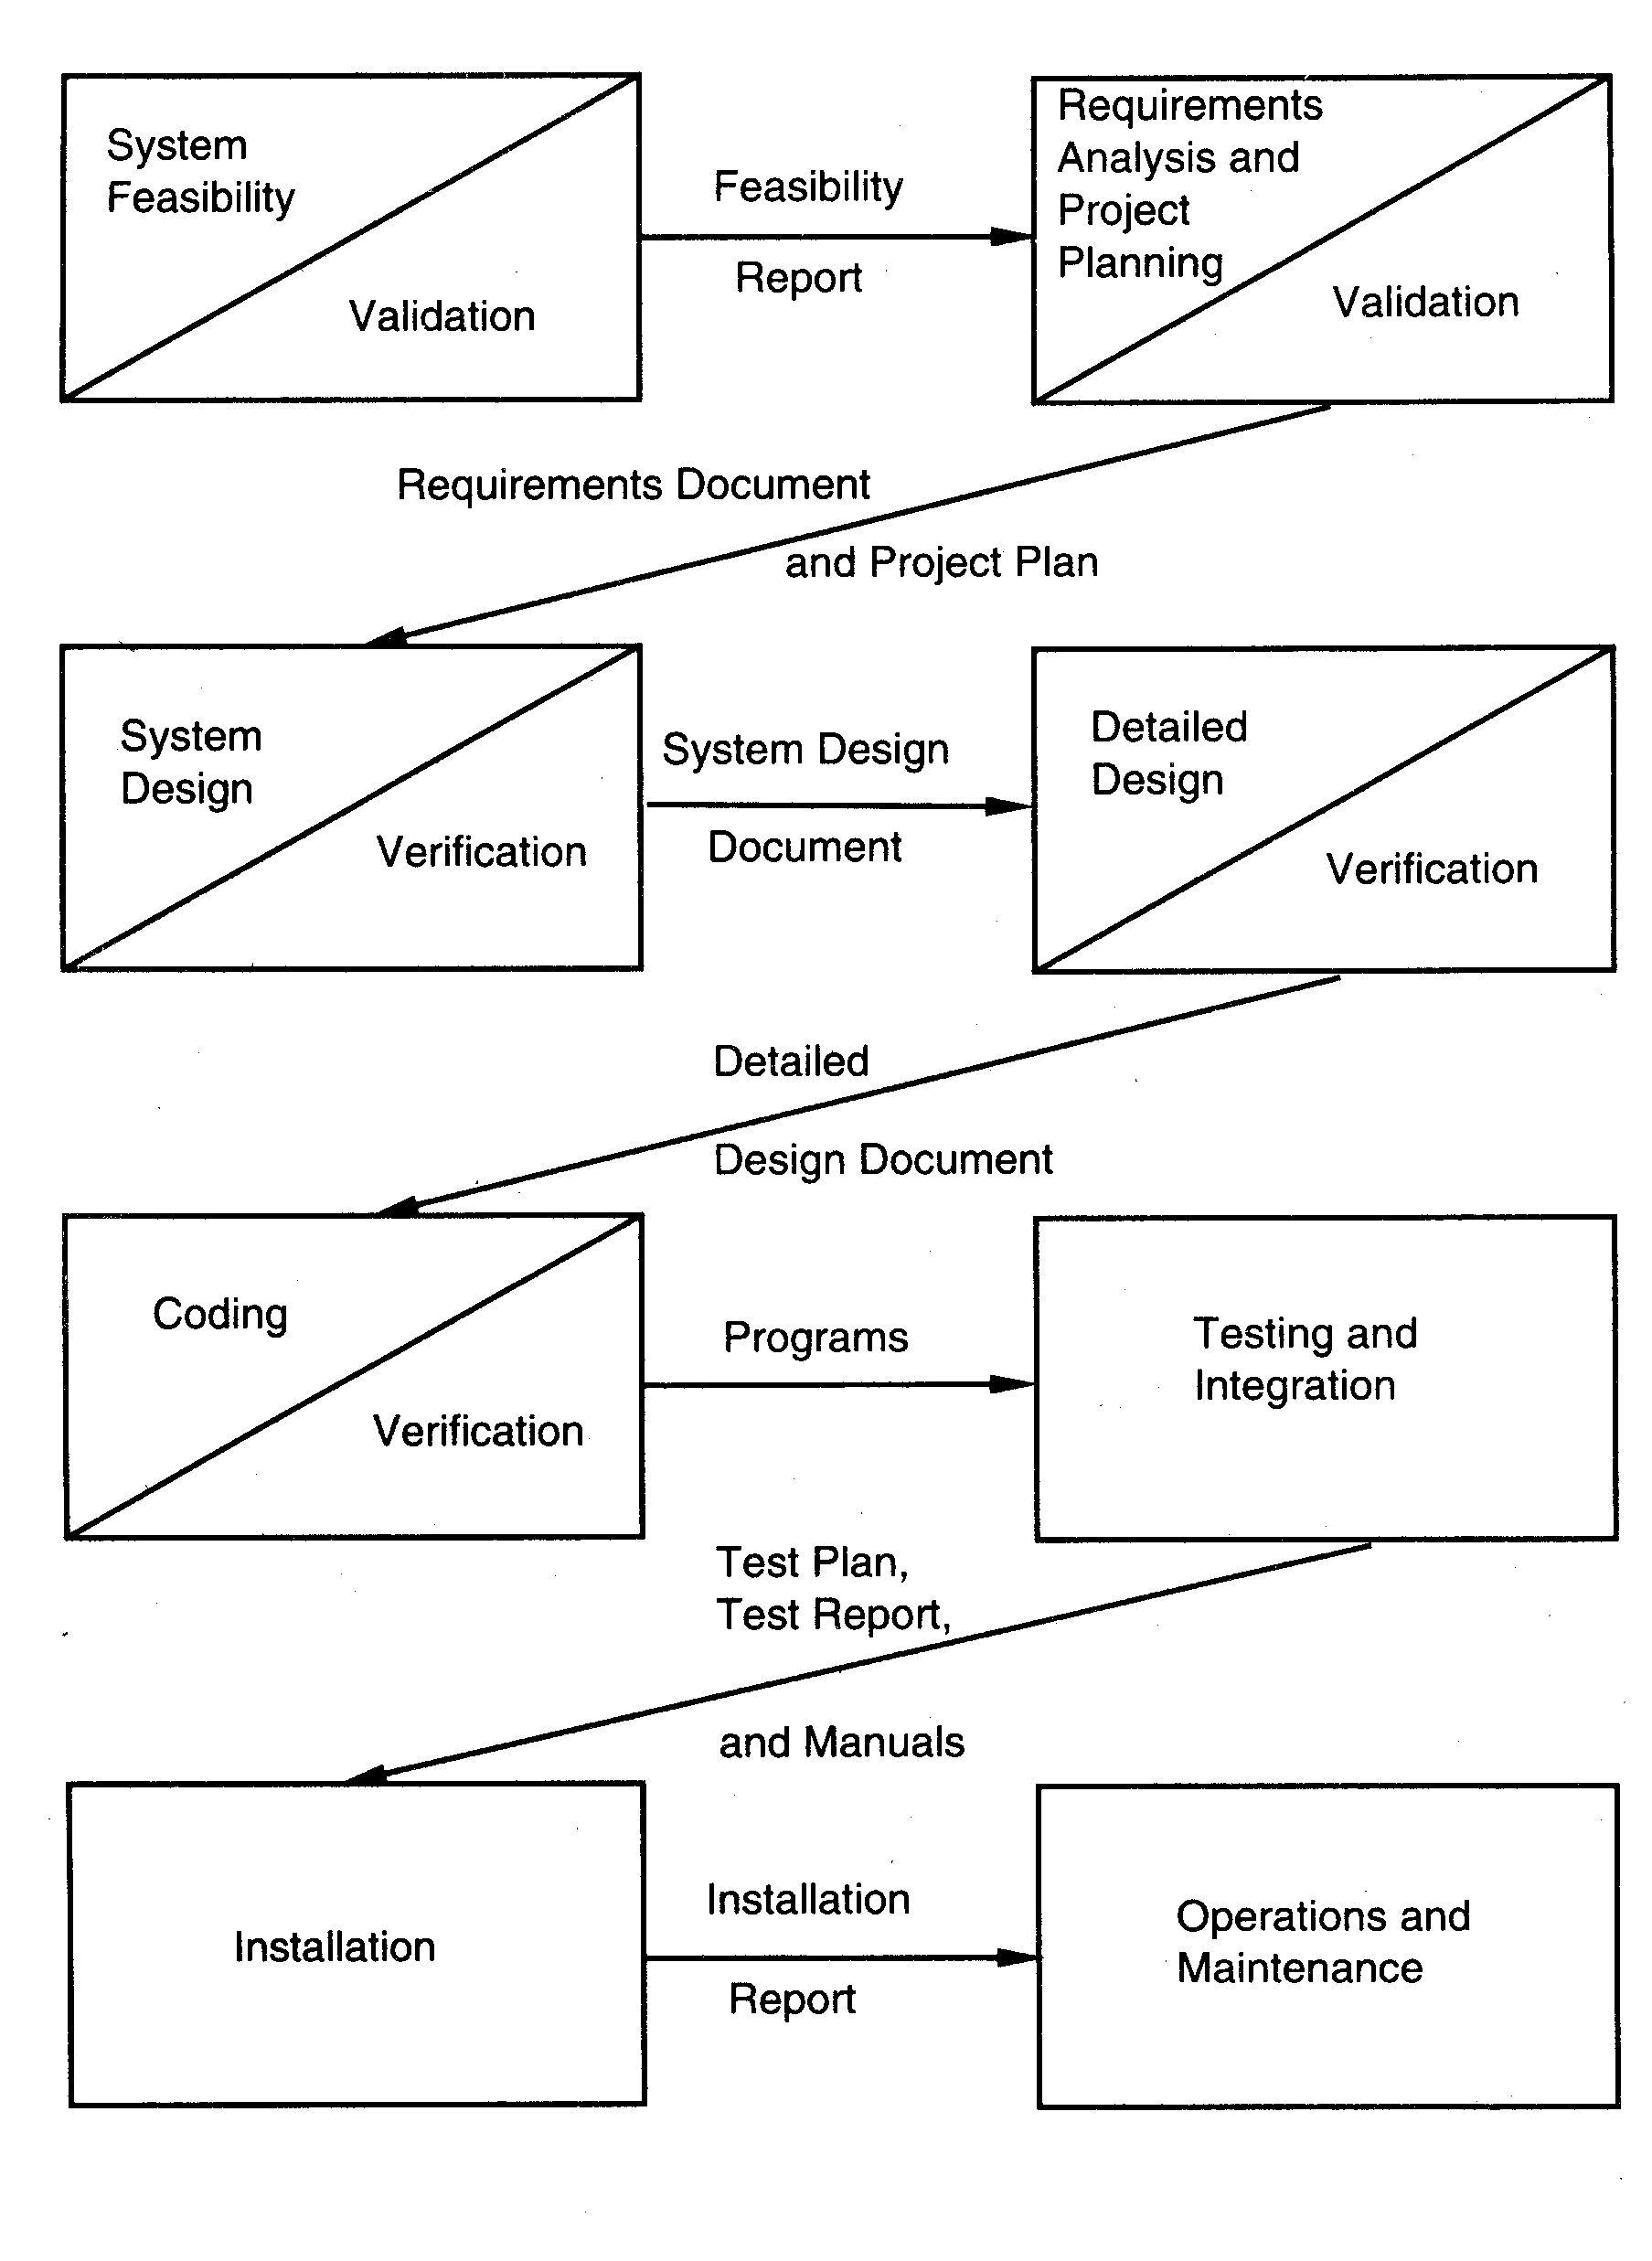
Sofware Process

Slide 21
Waterfall…
Linear ordering implies each phase should have some output
The output must be validated/certified
Outputs of earlier phases: work products
Common outputs of a waterfall: SRS, project plan, design docs, test plan and reports, final code, supporting docs
Sofware Process

Slide 22
Waterfall Advantages
Conceptually simple, cleanly divides the problem into distinct phases that can be performed independently
Natural approach for problem solving
Easy to administer in a contractual setup – each phase is a milestone
Sofware Process

Slide 23
Waterfall disadvantages
Assumes that requirements can be specified and frozen early
May fix hardware and other technologies too early
Follows the “big bang” approach – all or nothing delivery; too risky
Very document oriented, requiring docs at the end of each phase
Sofware Process

Slide 24
Waterfall Usage
Has been used widely
Well suited for projects where requirements can be understood easily and technology decisions are easy
I.e. for familiar type of projects it still may be the most optimum
Sofware Process

Slide 25
Prototyping
Prototyping addresses the requirement specification limitation of waterfall
Instead of freezing requirements only by discussions, a prototype is built to understand the requirements
Helps alleviate the requirements risk
A small waterfall model replaces the requirements stage
Sofware Process

Slide 26
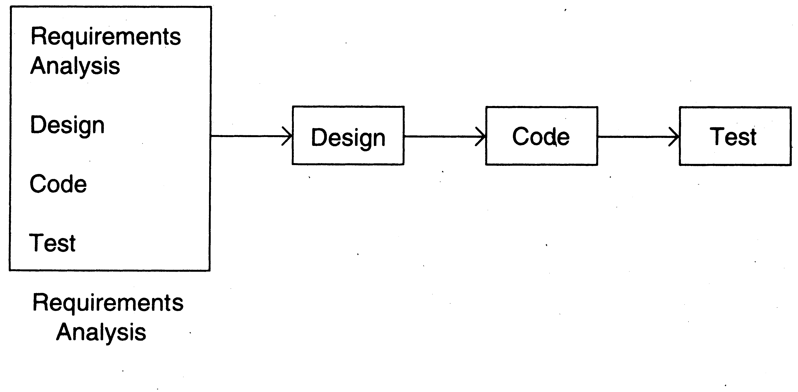
Prototyping
Sofware Process

Slide 27
Prototyping
Development of prototype
  Starts with initial requirements
  Only key features which need better understanding are included in prototype
  No point in including those features that are well understood
  Feedback from users are taken to improve the understanding of the requirements
Sofware Process

Slide 28
Prototyping
Cost can be kept low
  Build only features needing clarification
  “quick and dirty” – quality not important, scripting etc can be used
  Things like exception handling, recovery, standards are omitted
  Cost can be a few % of the total
  Learning in prototype building will help in building, besides improved requirements
Sofware Process

Slide 29
Prototyping
Advantages: req will be more stable, req frozen later, experience helps in the main development
Disadvantages: Potential hit on cost and schedule
Applicability: When req are hard to elicit and confidence in reqs is low; i.e. where reqs are not well understood
Sofware Process

Slide 30
Iterative Development
Counters the “all or nothing” drawback of the waterfall model
Combines benefit of prototyping and waterfall
Develop and deliver software in increments
Each increment is complete in itself
Can be viewed as a sequence of waterfalls
Feedback from one iteration is used in the future iterations
Sofware Process

Slide 31
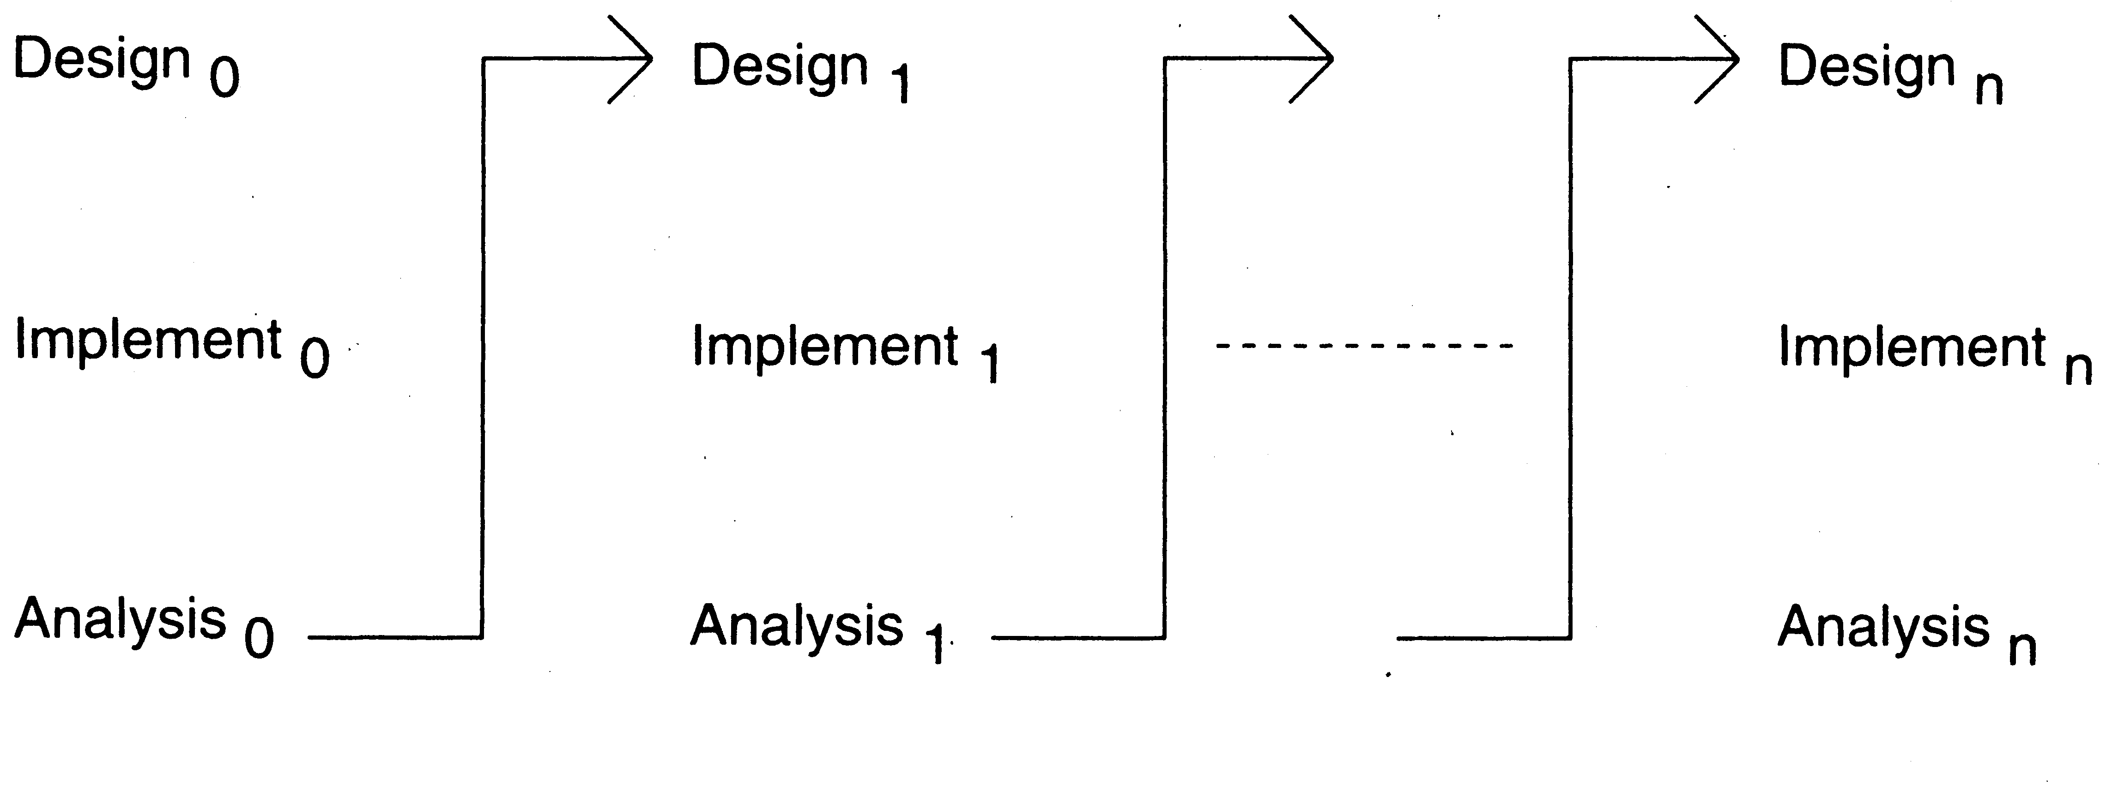
Iterative Enhancement
Sofware Process

Slide 32
Iterative Development
Products almost always follow it
Used commonly in customized development also
  Businesses want quick response for sw
  Cannot afford the risk of all-or-nothing
Newer approaches like XP, Agile,… all rely on iterative development
Sofware Process

Slide 33
Iterative Development
Benefits: Get-as-you-pay, feedback for improvement,
Drawbacks: Architecture/design may not be optimal, rework may increase, total cost may be more
Applicability: where response time is important, risk of long projects cannot be taken, all req not known
Sofware Process

Slide 34
Another Form of Iterative
The first iteration does the requirements and architecture in the waterfall way
The development and delivery is done incrementally in iterations
Sofware Process

Slide 35
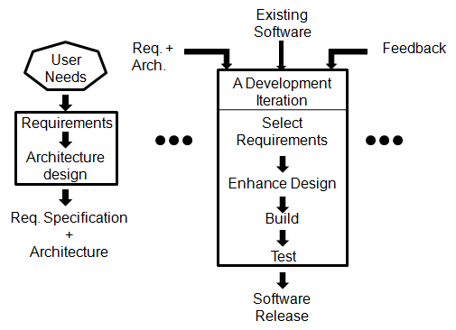
Another form of Iteration…
Sofware Process

Slide 36
Timeboxing
Iterative is linear sequence of iterations
Each iteration is a mini waterfall – decide the specs, then plan the iteration
Time boxing – fix an iteration duration, then determine the specs
Divide iteration in a few equal stages
Use pipelining concepts to execute iterations in parallel
Sofware Process

Slide 37
Time Boxed Iterations
General iterative development – fix the functionality for each iteration, then plan and execute it
In time boxed iterations – fix the duration of iteration and adjust the functionality to fit it
Completion time is fixed, the functionality to be delivered is flexible
Sofware Process

Slide 38
Time boxed Iteration
This itself very useful in many situations
Has predictable delivery times
Overall product release and marketing can be better planned
Makes time a non-negotiable parameter and helps focus attention on schedule
Prevents requirements bloating
Overall dev time is still unchanged
Sofware Process

Slide 39
Timeboxing – Taking Time Boxed Iterations Further
What if we have multiple iterations executing in parallel
Can reduce the average completion time by exploiting parallelism
For parallel execution, can borrow pipelining concepts from hardware
This leads to Timeboxing Process Model
Sofware Process

Slide 40
Timeboxing Model – Basics
Development is done iteratively in fixed duration time boxes
Each time box divided in fixed stages
Each stage performs a clearly defined task that can be done independently
Each stage approximately equal in duration
There is a dedicated team for each stage
When one stage team finishes, it hands over the project to the next team
Sofware Process

Slide 41
Example
An iteration with three stages – Analysis, Build, Deploy
  These stages are appx equal in many situations
  Can adjust durations by determining the boudaries suitably
  Can adjust duration by adjusting the team size for each stage
Have separate teams for A, B, and D
Sofware Process

Slide 42
Pipelined Execution
AT starts executing it-1
AT finishes, hands over it-1 to BT, starts executing it-2
AT finishes it-2, hands over to BT; BT finishes it-1, hands over to DT; AT starts it-3, BT starts it-2 (and DT, it-1)
…
Sofware Process

Slide 43
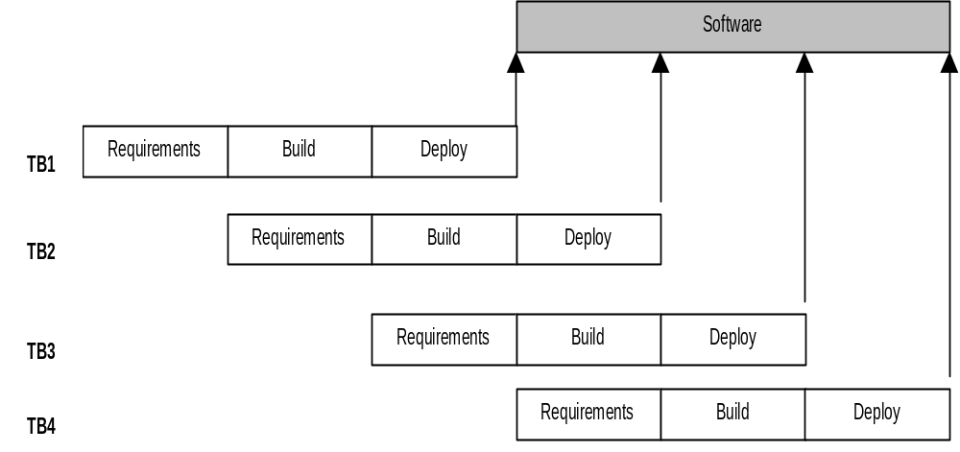
Timeboxing Execution
Sofware Process

Slide 44
Timeboxing execution
First iteration finishes at time T
Second finishes at T+T/3; third at T+2 T/3, and so on
In steady state, delivery every T/3 time
If T is 3 weeks, first delivery after 3 wks, 2nd after 4 wks, 3rd after 5 wks,…
In linear execution, delivery times will be 3 wks, 6 wks, 9 wks,…
Sofware Process

Slide 45
Timeboxing execution
Duration of each iteration still the same
Total work done in a time box is also the same
Productivity of a time box is same
Yet, average cycle time or delivery time has reduced to a third
Sofware Process

Slide 46
Team Size
In linear execution of iterations, the same team performs all stages
If each stage has a team of S, in linear execution the team size is S
In pipelined execution, the team size is three times (one for each stage)
I.e. the total team size in timeboxing is larger; and this reduces cycle time
Sofware Process

Slide 47
Team Size
Merely by increasing the team size we cannot reduce cycle time - Brook’s law
Timeboxing allows structured way to add manpower to reduce cycle time
Note that we cannot change the time of an iteration – Brook’s law still holds
Work allocation different to allow larger team to function properly
Sofware Process

Slide 48
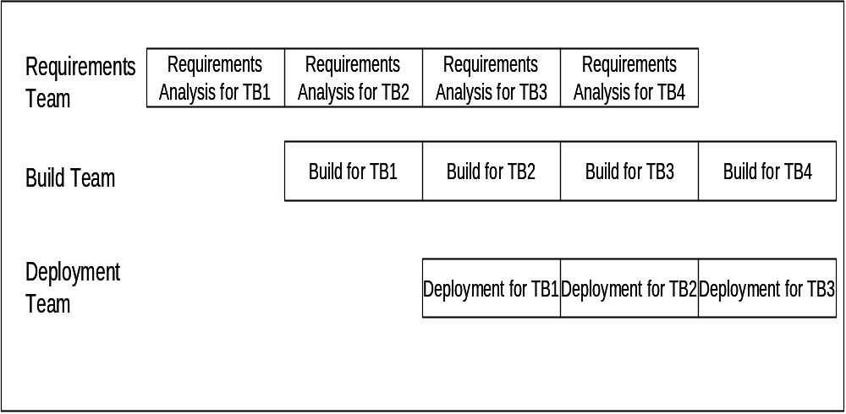
Work Allocation of Teams
Sofware Process

Slide 49
Timeboxing
Advantages: Shortened delivery times, other adv of iterative, distr. execution
Disadvantages: Larger teams, proj mgmt is harder, high synchronization needed, CM is harder
Applicability: When short delivery times v. imp.; architecture is stable; flexibility in feature grouping
Sofware Process

Slide 50
Spiral Model
Proposed by Boehm in 1988.
Each loop of the spiral represents a phase of the software process:
  the innermost loop might be concerned with system feasibility,
  the next loop with system requirements definition,
  the next one with system design, and so on.
There are no fixed phases in this model, the phases shown in the figure are just examples.

Slide 51
Spiral Model (CONT.)
The team must decide:
  how to structure the project into phases.
Start work using some generic model:
  add extra phases
    for specific projects or when problems are identified during a project.
Each loop in the spiral is split into four sectors (quadrants).

Slide 52
Spiral Model
Determine Objectives
Identify & Resolve Risks
Customer Evaluation of Prototype
Develop Next Level of Product

Slide 53
Objective Setting (First Quadrant)
Identify objectives of the phase,
Examine the risks associated with these objectives.
  Risk:
    any adverse circumstance that might hamper successful completion of a software project.
Find alternate solutions possible.

Slide 54
Risk Assessment and Reduction (Second Quadrant)
For each identified project risk,
  a detailed analysis is carried out.
Steps are taken to reduce the risk.
For example, if there is a risk that the requirements are inappropriate:
  a prototype system may be developed.

Slide 55
Spiral Model (CONT.)
Development and Validation (Third quadrant):
  develop and validate the next level of the product.
Review and Planning (Fourth quadrant):
  review the results achieved so far with the customer and plan the next iteration around the spiral.
With each iteration around the spiral:
  progressively more complete version of the software gets built.

Slide 56
Spiral Model as a meta model
Subsumes all discussed models:
  a single loop spiral represents waterfall model.
  uses an evolutionary approach --
    iterations through the spiral are evolutionary levels.
  enables understanding and reacting to risks during each iteration along the spiral.
  uses:
    prototyping as a risk reduction mechanism
    retains the step-wise approach of the waterfall model.

Slide 57
RUP Model
Rational Unified Process is another iterative model
Software development is divided into cycles, each cycle delivering a fully working system
Each cycle executed as separate project
Execution of a cycle is broken into four consecutive phases, each phase ending with a milestone achievement
Sofware Process

Slide 58
Phases in a Project: Inception phase
Communication and planning are the main ones.
Identifies the scope of the project using a use-case model allowing managers to estimate costs and time required.
Customers’ requirements are identified and then it becomes easy to make a plan for the project.
The project plan, Project goal, risks, use-case model, and Project description, are made.
The project is checked against the milestone criteria and if it couldn’t pass these criteria then the project can be either canceled or redesigned.
Sofware Process

Slide 59
Elaboration phase
Planning and modeling are the main ones.
A detailed evaluation and development plan is carried out and diminishes the risks.
Revise or redefine the use-case model (approx. 80%), business case, and risks.
Again, checked against milestone criteria and if it couldn’t pass these criteria then again project can be canceled or redesigned.
Executable architecture baseline.
Sofware Process

Slide 60
Construction phase
The project is developed and completed.
System or source code is created and then testing is done.
Coding takes place.
Sofware Process

Slide 61
Transition phase
The final project is released to the public.
Transit the project from development into production.
Update project documentation.
Beta testing is conducted.
Defects are removed from the project based on feedback from the public.
Sofware Process

Slide 62
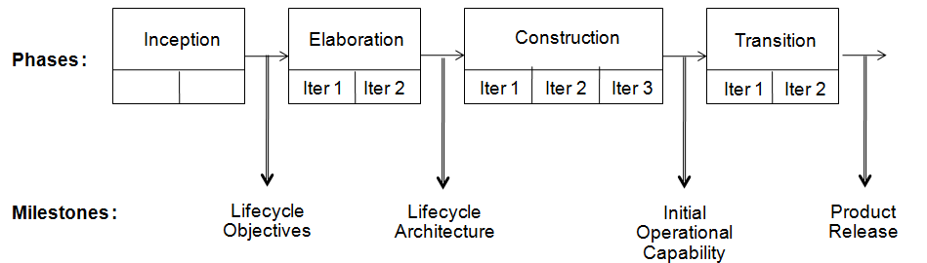
Phases and Milestones
Sofware Process

Slide 63
Execution of phases
Each phase itself can be done in multiple iterations, each iteration having an external/internal customer
Generally construction has multiple iterations;
elaboration can also be meaningfully done in multiple iterations
Sofware Process

Slide 64
Core workflows and phases
Engineering tasks are called core process workflows
These sub processes correspond to tasks of requirements, design, implementation, testing, proj mgmt, etc
Many sub processes may be active in a phase, the volume of activity generally differs depending on the project
Sofware Process

Slide 65
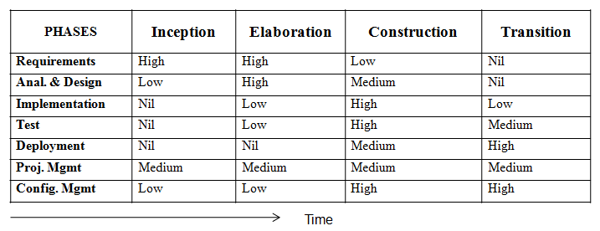
Sub processes and phases
Sofware Process

Slide 66
RUP
Sub processes are active in all phases
Volume of activity in each phase differs depending on the project
Hence, a project can use RUP to implement waterfall by having requirements process be active only in the elaboration phase
Or prototyping by having a lot of construction activity in the elaboration phase
RUP is therefore a flexible framework
Sofware Process

Slide 67
Agile Process Model
stressed on
  collaboration over documentation,
  self- organization rather than rigid management practices, and
  the ability to manage to constant change rather than lock yourself to a rigid waterfall development process.
Sofware Process

Slide 68
agile is designed for flexibility and adaptability
Does not define all the answers up front as you do in the waterfall method, but break the problem into components
Sofware Process

Slide 69
Extreme Programming or Agile Process Model
In software development, the term ‘agile’ is adapted to mean ‘the ability to respond to changes − changes from Requirements, Technology and People.’
Agile approaches developed in 90s as a reaction to document driven approaches
Most agile approaches have some common principles
  Working software is the measure of progress
  Software should be delivered in small increments
  Even late changes should be allowed
  Prefer face to face commn over documentation
  Continuous feedback and customer involvement is necessary
  Prefer simple design which evolves
  Delivery dates are decided by the empowered teams
  …
Sofware Process

Slide 70
XP…
Many agile methodologies have been proposed; extreme programming (XP) is one of the most popular
An XP project starts with user stories, which are short descr of user needs
  Details are not included
  Each user story written on a separate card so they can be combined in diff ways
Sofware Process

Slide 71
Overall Process
Team estimates how long it will take to implement a user story
  Estimates are rough
Release planning is done
  Defines which stories are to be built in which release, and dates for release
  Frequent and small releases encouraged
  Acceptance tests also built from user stories; used to test before release
  Bugs found in Acceptance Test (AT) are fixed in next release
Sofware Process

Slide 72
Overall Process
Development done in iterations of a few weeks each
  Iteration starts with planning, in which stories to be implemented are selected – high risk value are chosen first
  Details of stories obtained during the development and implemented
  Failed AT of previous iteration are also fixed
Sofware Process

Slide 73
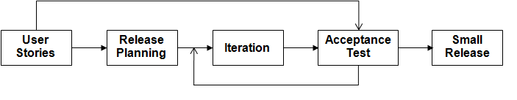
XP – Overall Process
Sofware Process

Slide 74
An Iteration
An iteration execution has some unique practices
  Pair programming: programming is done in pairs of programmers
    where two developers code together to drive higher quality code and to enable more senior developers to mentor junior ones.
  Test driven development – automated unit tests written before the code
  Simple solutions, refactoring for improving the design when need arises
  Frequent integration
Sofware Process

Slide 75
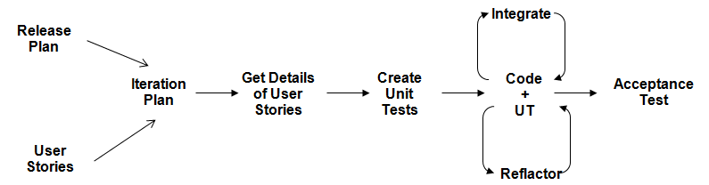
An Iteration
Sofware Process

Slide 76
XP - Summary
Well suited for situations where volume and pace of requirements is high
Customer is willing to engage heavily with the team
The team is collocated and is not too large (less than 20 or so)
Requires strong capability in team members
Sofware Process

Slide 77
Summary – waterfall
Strength | Weakness | Types of Projects
Simple Easy to execute Intuitive and logical Easy contractually | All or nothing – too risky Req frozen early May chose outdated hardware/tech Disallows changes No feedback from users Encourages req bloating | Well understood problems, short duration projects, automation of existing manual systems
Sofware Process

Slide 78
Summary – Prototyping
Strength | Weakness | Types of Projects
Helps req elicitation Reduces risk Better and more stable final system | Front heavy Possibly higher cost and schedule Encourages req bloating Disallows later change | Systems with novice users; or areas with req uncertainity. Heavy reporting based systems can benefit from UI proto
Sofware Process

Slide 79
Summary – Iterative
Strength | Weakness | Types of Projects
Regular deliveries, leading to biz benefit Can accommodate changes naturally Allows user feedback Avoids req bloating Naturally prioritizes req Allows reasonable exit points Reduces risks | Overhead of planning each iteration Total cost may increase System arch and design may suffer Rework may increase | For businesses where time is imp; risk of long projects cannot be taken; req not known and evolve with time
Sofware Process

Slide 80
Summary – Timeboxing
Strength | Weakness | Types of Projects
All benefits of iterative Planning for iterations somewhat easier Very short delivery times | PM becomes more complex Team size is larger Complicated – lapses can lead to losses | Where very short delivery times are very important Where flexibility in grouping features Arch is stable
Sofware Process

Slide 81
Summary – RUP
Strength | Weakness | Types of Projects
All benefits of iterative Provides a flexible framework for a range of projects | For each project, one has to design the process | Can be applied to a wide range as it allows flexibility
Sofware Process

Slide 82
Summary – XP
Strength | Weakness | Types of Projects
Agile and responsive Short delivery cycles Continuous feedback can lead to better acceptance | Can tend to become ad-hoc Lack of documentation can be an issue Continuous code change is risky | Where requirements are changing a lot, customer is deeply engaged in development, and where the size of the project is not too large
Sofware Process

Slide 83
Using Process Model in a Project
Model to be used should be selected based on the nature of the problem
Example: Build a small auction system for a Univ, tight schedule, some core req, customer time only in start,…
Suitable model: Iterative delivery – do req in 1st iter; and two rounds of delivery; minimizes risk,…
Sofware Process

Slide 84
Using Process Models..
Example: Highly competitive product; req change rapidly; outsourcing is desired for reducing cost,…
Model: XP not OK as collocated team needed; iterative may not deliver rapidly enough; timeboxing best suited
Sofware Process

Slide 85
Summary
Process is a means to achieve project objectives of high QP
Process models define generic process, which can form basis of project process
Process typically has stages, each stage focusing on an identifiable task
Many models for development process have been proposed
Sofware Process

Slide 86
Summary
Development process models discussed
  Waterfall
  Prototyping
  Iterative
  RUP
  Timeboxing
  Agile or XP
Each has its strengths and weaknesses and will work well for some types of projects
Sofware Process

Slide 87
Project Management Process
Sofware Process

Slide 88
Background
Development process divides development into phases and activities
To execute it efficiently, must allocate resources, manage them, monitor progress, take corrective actions, …
These are all part of the PM process
Hence, PM process is an essential part of executing a project
Sofware Process

Slide 89
PM Process Phases
There are three broad phases
  Planning
  Monitoring and control
  Termination analysis
Planning is a key activity that produces a plan, which forms the basis of monitoring
Sofware Process

Slide 90
Planning
Done before project begins
Key tasks
  Cost and schedule estimation
  Staffing
  Monitoring and risk mgmt plans
  Quality assurance plans
  Etc.
Will discuss planning in detail later
Sofware Process

Slide 91
Monitoring and control
Lasts for the duration of the project and covers the development process
  Monitors all key parameters like cost, schedule, risks
  Takes corrective actions when needed
  Needs information on the dev process – provided by metrics
Sofware Process

Slide 92
Termination Analysis
Termination analysis is performed when the development process is over
Basic purpose: to analyze the perf of the process, and identify lessons learned
Also called postmortem analysis
Sofware Process

Slide 93
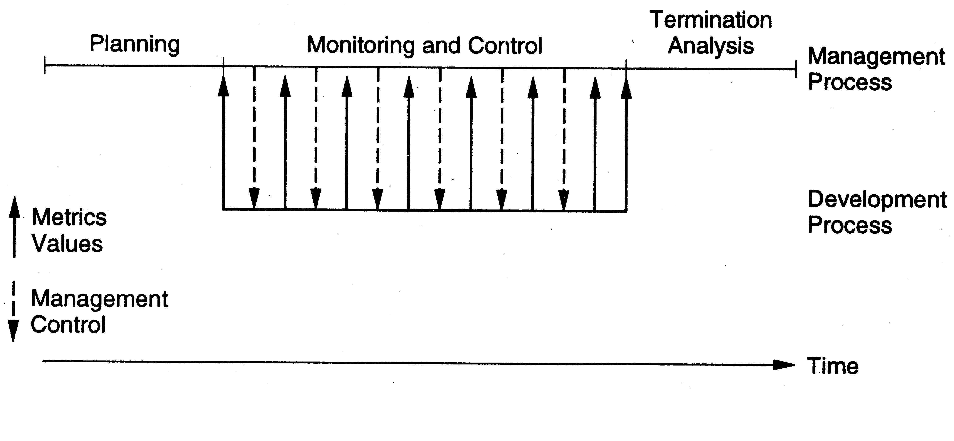
Relationship with Dev Process
Sofware Process

Slide 94
Summary
Process has a major impact on the quality and productivity
Different processes at work in a software project
We have focused on development process and project management process
Process models are general process structures, that work well for some types of problems
A project should select a process model that is best suited for it (and tailor it to meet its requirements)
Sofware Process

